Slide 1


Smart cities, smart specialisation and synergies
Richard Tuffs, Director ERRIN
(Un)Plugging Data in Smart City-Regions
Bridging European Urban Transformations
Workshop Series in Brussels 2016-2017
Funded by the ESRC
1st Workshop Brussels Nov 14th 2016
www.errin.eu

Slide 2
Outline
Brief overview of ERRIN
Developing regional and city innovation ecosystems
  Triple helix, quadruple helix…
Developing synergies
  Smart specialisation
  Difficulties
The need for citizen engagement
  EIP Smart Cities Citizen Manifesto
Conclusions

Slide 3
ERRIN Four Ps
Juncker Plan
Synergies
Smart Specialisation
Innovation Council
Policy
Projects
Partner-
ship
Profile
  Influencing EU Research
  & Innovation
Policy
Project Brokerage sessions:
Interreg-Europe
March 17th
ICT/KETS /Health and SSH
June 21st-22nd
Energy 25th Oct
Working with our members
Joint events – EURADA/ERRIN and CEFIC/ERRIN
MoUs
Partner Searches on website
www.errin.eu
Average of +2 events/invitations to speak per week
ERRIN in ‘SmartSpec Project’ with ten ERRIN regions
Supporting project development and
engaging ERRIN regions in EU projects
Raising the profile of ERRIN
and member regions in Brussels

Slide 4
ERRIN Working Groups 2016
Energy & Climate Change
Health
Water / Process Industry
Transport
Smart Cities
Tourism
Advanced manufacturing/ Nano
Blue Growth
Design & Creativity
ICT
Opening Science
Bio-economy/ Food & Agri
Innovation & Investment
Smart Specialisation
Policy

Slide 5
Working Groups and Leaders 2016
Strategic
Societal
Energy – Scotland Europa, Flanders, West Finland & South Denmark
Transport & Logistics – Aragon, Ile de France & Scotland
Industry
Advanced manufacturing & nano – Twente University, Rhone-Alpes, West Mids & Basque Country
Bio economy, food & sustainable agriculture – West Finland, Northern Ireland, Navarra, Pays de la Loire & Veneto
X-cutting
Smart Cities Communities & Regions –Eindhoven, East & North Finland , North Sweden, Noord Regio & Stavanger
Health – Stavanger, South Denmark, Skåne & Lombardy
Water – Fryslan & Puglia
ICT – Zealand, Berlin & Extremadura
Design & creativity – Central Denmark, Lombardy & Stuttgart
Tourism – Valencia, Crete, Lombardy & Saxony Anhalt
Policy – Scotland Europa, East & North Finland & South Tyrol
Projects – West Midlands, Eindhoven & Lombardy
Opening Science – Bremen, Berlin, Capital Region DK & Wales Higher Education
Blue Innovation & Growth – Brittany, Pomorskie & Emilia Romagna
Innovation & investment – Cantabria, Eindhoven, KEPA & Trento
Smart Specialisation – Scotland Europa, PACA, Helsinki & Malta
Over 40 regions involved in
leading Working Groups

Slide 6
Working Groups – what do they do?
Developing positions
EU institutions - speakers
Working Group
Policy
Projects
Partnership
Profile
Visibility
Regional presentations
Brokerage sessions x 1 per year
Regional interests &
competences
Early intelligence
Working Groups
Develop an annual work plan with broad objectives and planning
Meet approx 4 times per year
Most meetings involve Brussels representatives
Regional experts needed for brokerage events for project development
Project dissemination
Sharing knowledge
Other networks
Mutual learning
Making contacts

Slide 7
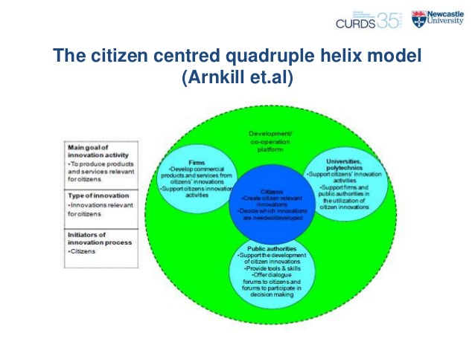
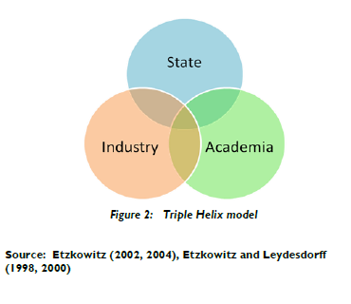
Triple helix >>>>>>>> Quadruple helix
Triple helix linkages seen as important for city/regional competitiveness and jobs and growth

Slide 8

Quadruple helix and Innovation 2.0

Slide 9
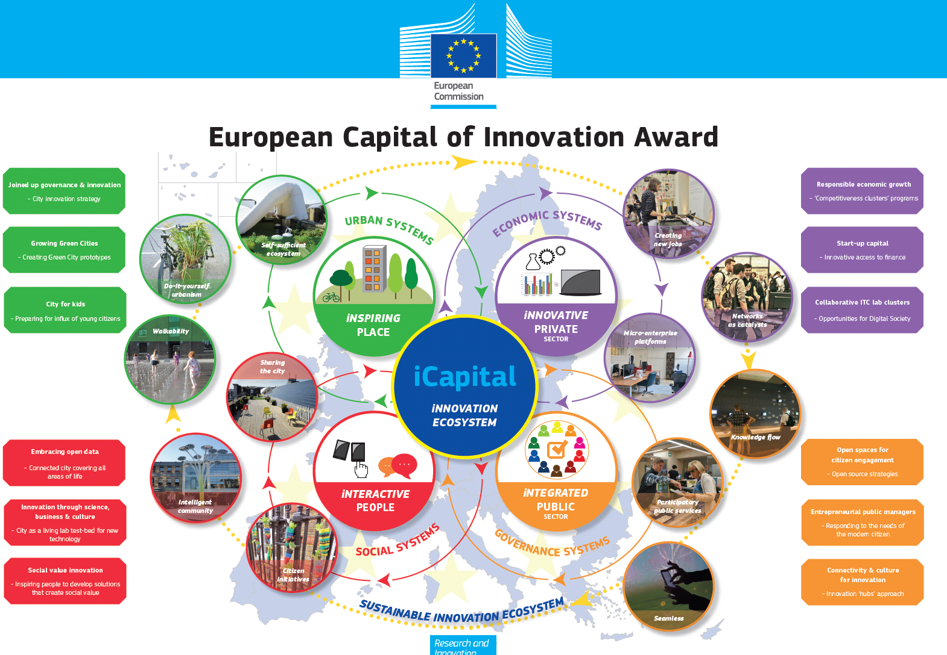
Capital of Innovation

Slide 10
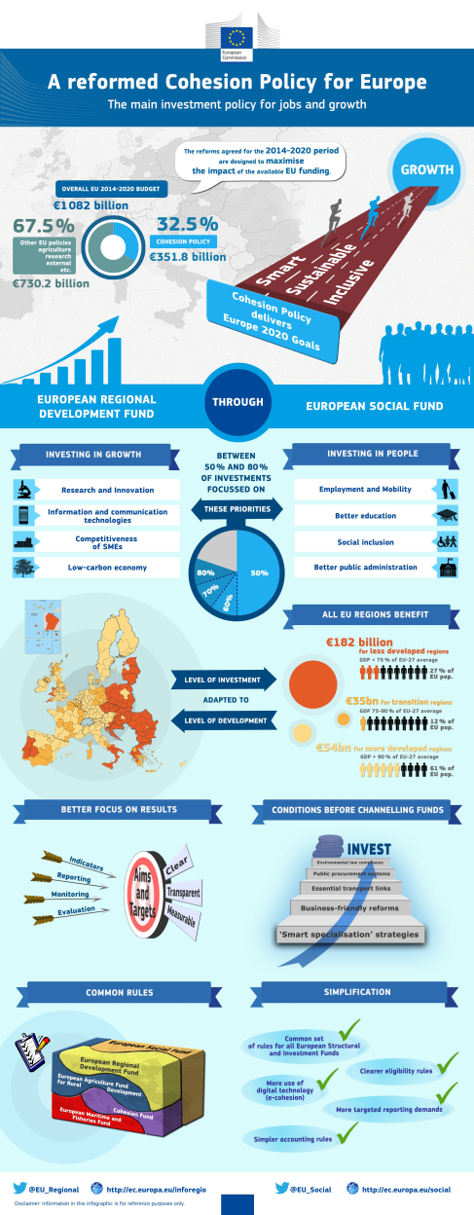
Research and innovation and regional policy
Smart
Specialisation and synergies

Slide 11
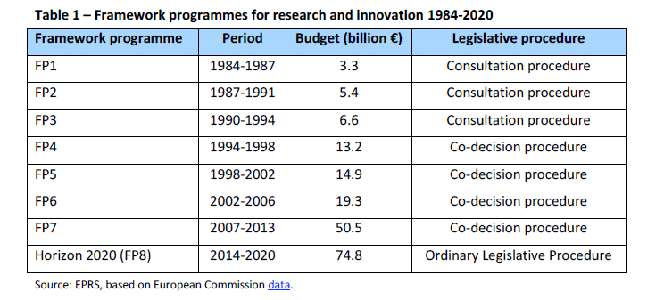
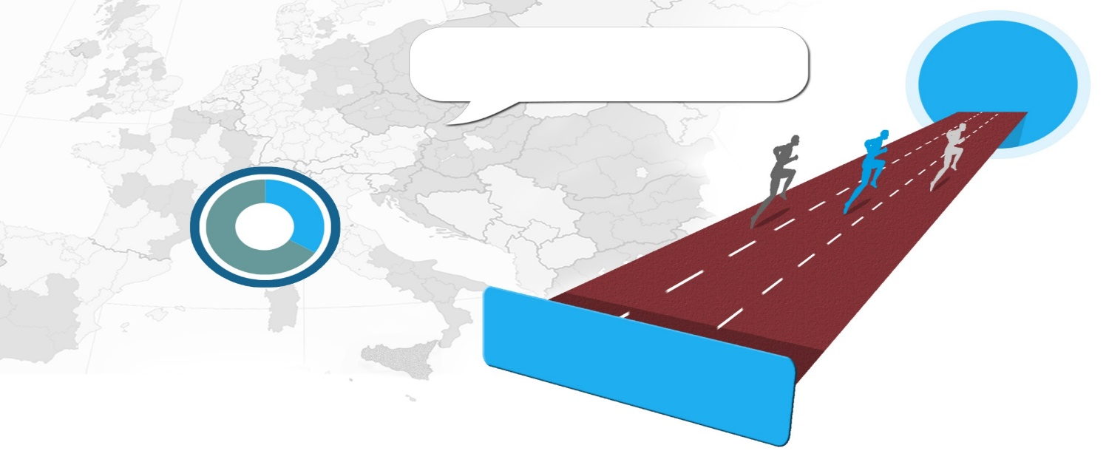
Triple helix supported by EU funding
Horizon 2020 – €75 billion
European Structural and Investment Fund €352 billion
The reforms agreed for the 2014-2020 period are designed to maximise the impact of the available EU funding.
GROWTH
OVERALL EU 2014-2020 BUDGET
€1 082 billion
67.5%
32.5%
Other EU policies
Agruculture
Research
External
Etc.
COHESION POLICY
€351.8 billion
Smart
Sustainable
€730.2 billion
Inclusive
Cohesion Policy
delivers
Europe 2020 Strategy

Slide 12
The call for synergies
Building meaningful interactions between the two policy frameworks and their investment strategies can have significant impacts on the economy, combining place-based innovation investments in smart specialisation priorities with world-class research and innovation initiatives, thus ensuring a higher impact of the funds.
Fostering synergies will not only bring about better efficiency, it will ultimately lead to a positive impact on jobs, growth and competitiveness across Europe's diverse regions – a positive impact from investing more in developing regional research and innovation capacities, the drivers of economic growth in the Union.

Slide 13
Synergies
Synergy-type 1: Providing funding from alternative sources for positively evaluated Framework Programme/Horizon 2020 proposals but not funded due to insufficient Call budgets
Synergy-type 2: Funding actions that build research and innovation capacities of actors aimed at participating in the Framework Programme/Horizon 2020 or other internationally competitive research and innovation programmes (sequential - upstream)
Synergy-type 3: Funding actions that capitalise on already implemented Framework Programme/Horizon 2020 research and innovation actions aimed at market up-take (sequential - downstream)
Synergy-type 4: Combining funding from the Framework Programme/Horizon 2020 and the ESI Funds (and/or from other sources) for coordinated parallel actions that complement each other
Synergy-type 5: Bringing together funding from Horizon 2020 and the ESI Funds in an integrated research and innovation project that could be a single action or a group of inter-dependent actions or operations

Slide 14
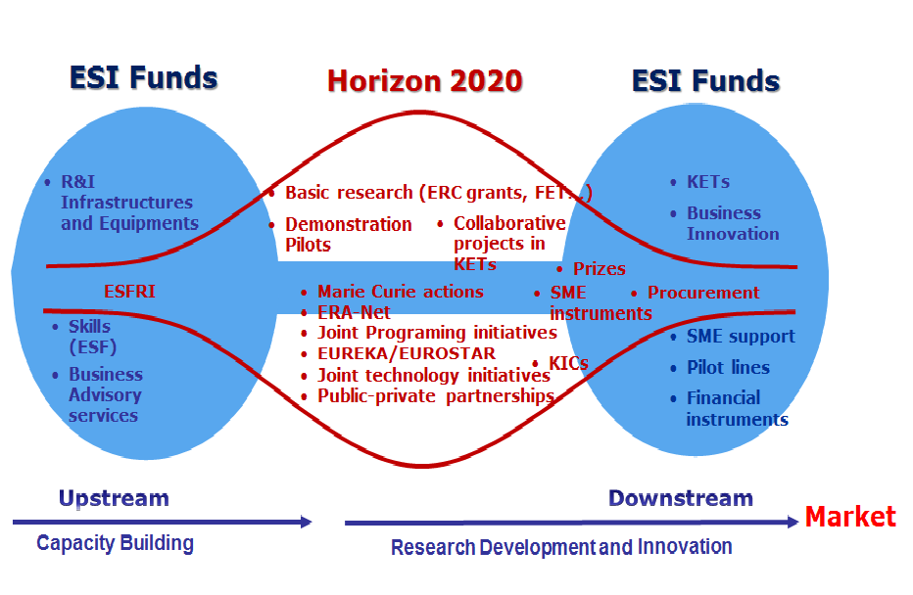
Synergies
Synergy-type 1 – funding successful H2020 projects via ESIF
Synergy-type 2
Synergy-type 3
Synergy-type 4 – parallel actions
Synergy-type 5 – integrated actions

Slide 15
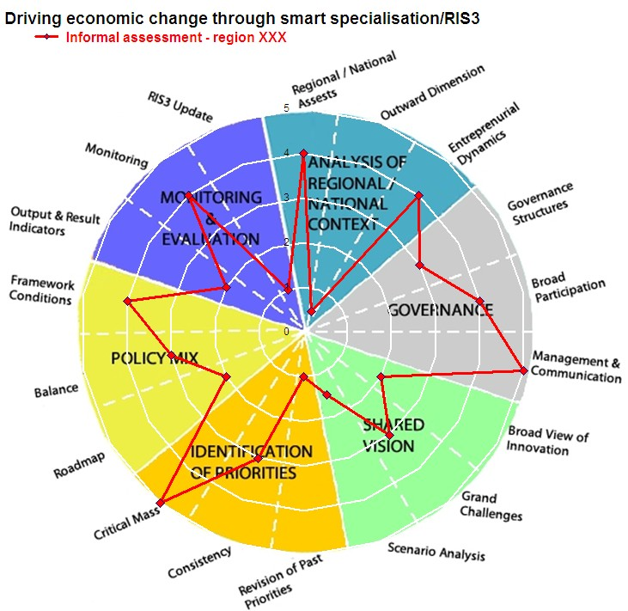
Smart specialisation
Breaking with the past while building on the past…
Identifying priorities through a process of Entrepreneurial Discovery Process – engaging stakeholders in identifying competitive advantage

Slide 16
Smart specialisation 2.0 : three dimensions
Growth and jobs
Territorial development
Societal challenge
University dimension
Solving grand challenges
Economic approach
Entrepreneurial
Discovery Process
What roles for regions?
Implementation, impact…
What role for EU?
Policy…
Funding support…
Territorial strategies

Slide 17
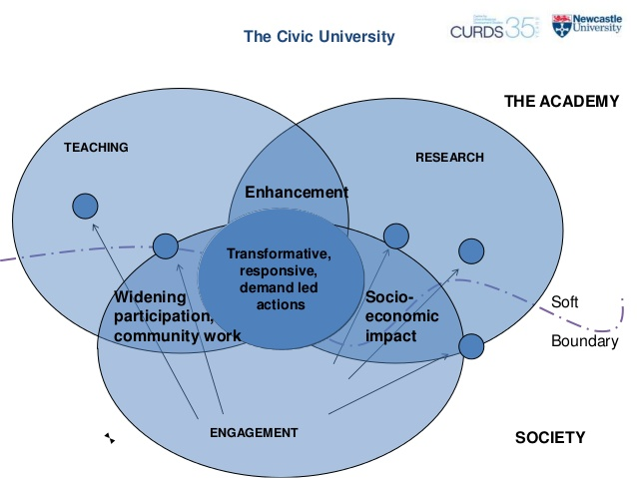
Synergies: A new role
Growth and jobs
Territorial development
Societal challenge

Slide 18
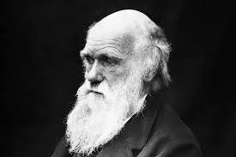
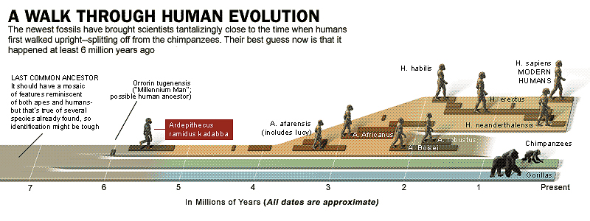
Darwinism

Slide 19



Two tribes: research v administration

Slide 20
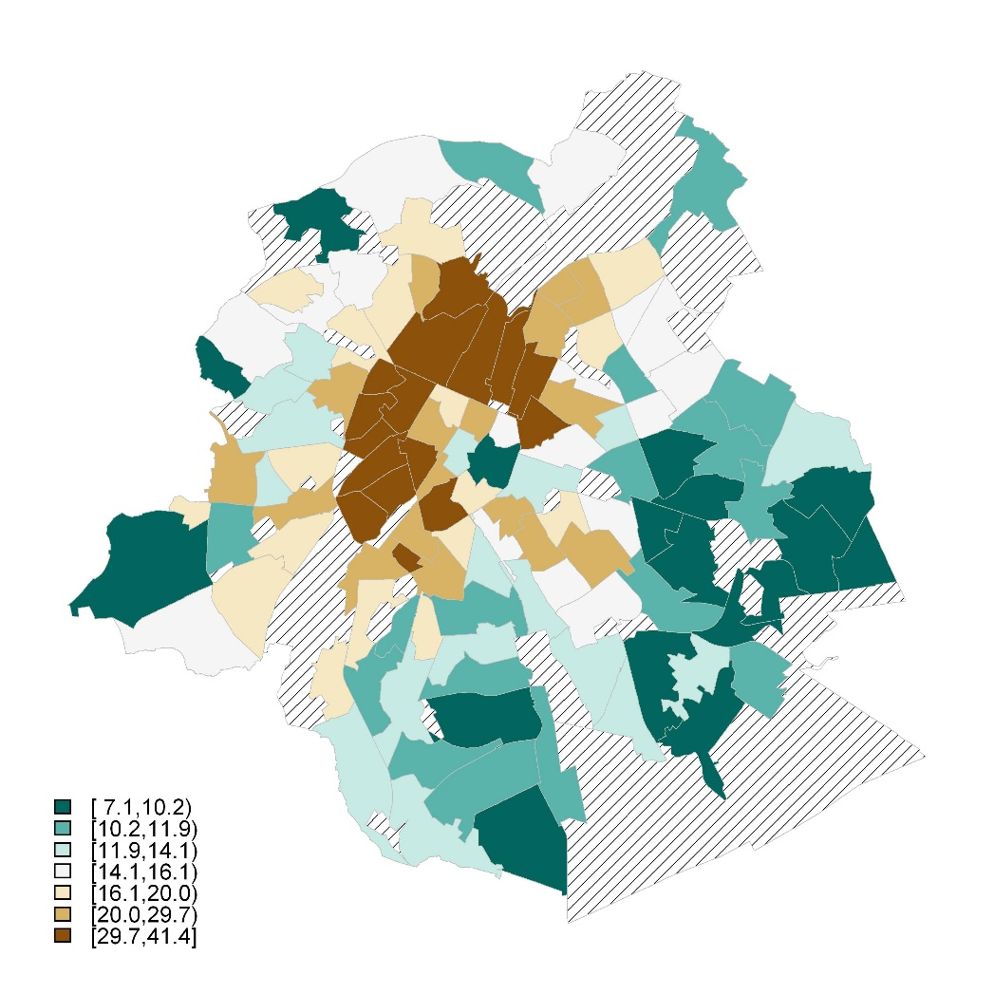
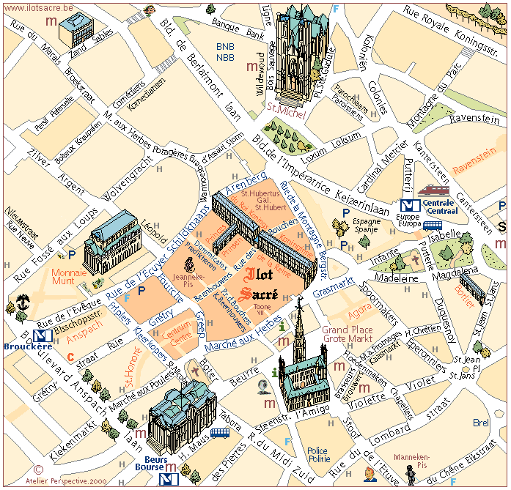
Mental maps

Slide 21
Smart cities – evolution
?
Homo synergus

Slide 22
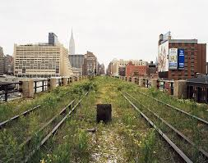

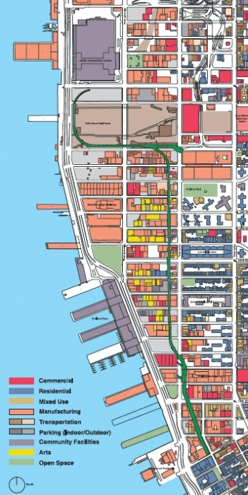

New visions are possible…

Slide 23

Inclusive smart cities – manifesto on citizen engagement
Leadership in citizen engagement…
Develop and exploit new and existing collaborative models…
Improve procurement and assessment procedures…
Promote the use of open data and/or an appropriate access to data by citizens, developers…
Promote open innovation and open science to foster smart citizens.
Make the involvement of citizens an important factor in research and innovation projects (such as science with and for society, responsible research and innovation, gender and diversity mainstreaming in innovation and research) and promote it through a citizen science- based approach. Actively support the building of regional innovation ecosystems, foster quadruple helix cooperation (among city-regions/universities/business and civil society organisations) and highlight the importance of people-centred design. Promote the practice of regional clusters linked to rural surroundings, building on entrepreneurship, replicable concepts and peer learning, and seeking collaboration with other clusters and initiatives.
https://eu-smartcities.eu/content/inclusive-smart-cities-european-manifesto-citizen-engagement

Slide 24
Citizen concerns (1)

Slide 25
Citizen concerns (2)

Slide 26
Overview
Regional and city innovation ecosystems seen as driver for innovation and jobs and growth
Regional innovation systems built on triple helix systems
But questions…
These systems need synergies but complex – need new roles – what and who and how…?
Increasing engagement of citizens – quadruple helix – but how?
The need for smart to permeate citizen concerns – but how?

Slide 27





    Ryan Titley
    Communication &
    Planning Manager
    communication@errin.eu
    Andrea Lagundzija
    Member Relations Manager
    members@errin.eu
    Anett Ruszanov
    Projects Manager
    projects@errin.eu
    Richard Tuffs
    Director
    director@errin.eu
    Nordic House
    3 rue du Luxembourg
    B-1000 Brussels
    Tel +32 2 503 3554
    www.errin.eu
    @ERRINNetwork
    ERRINNetwork
    ERRIN Group
for listening

